Slide 1
Statues of my projects
Main projects:
Single cell type atlas project – submitting
PKLR KO project– manuscript in preparation
Transcript isoform atlas project - ongoing
Pathology atlas ver 2– in preparation
PKM project – under review
Side projects:
Collaboration with Pacher’s group – finished
Macaque atlas project – in preparation
Brain study – ongoing
Sarcoma with Adil Duru – ongoing
Microbiome Atlas Project – data transferred
Notes:
Figure legend:
Figure 1. Efficiency of genetic transfection and its impact on growth of HepG2 cells by transfection of gene specific siRNA or Plasmid
A. HepG2 cells were transfected using siRNA with specific target genes. And efficiency of transfection was validated by quantitative RT-PCR assay on expression of target genes. Compared to negative control, PKLR was inhibited to 0.04±0.002, PNPLA3 was inhibited to 0.07±0.01, and PCSK9 was inhibited to 0.06±0.005, under the intervention of siRNA.
B. HepG2 cells were transfected using expression plasmid with specific target genes. And efficiency of transfection was validated by quantitative RT-PCR assay on expression of target genes. Compared to negative control, the fold changes (FC) for PKLR was 1694.3±254.6, the FC for PNPLA3 was 859.8±113.5, and the FC for PCSK9 was 4.79±0.33, under intervention of corresponding expression plasmids.
C. Assay on HepG2 cell growth after transfection by gene specific siRNA. Compared to cells with negative control siRNA, cell growth was inhibited significantly for down-regulation of target genes (inhibitory rate: 13.7%±1.0% for PKLR, 22.9%±2.5% for PNPLA3, and 15.7%±2.2% for PCSK9, P<0.05).
D. Assay on HepG2 cell growth after transfection by gene specific plasmids.
The cell growth was promoted significantly by gene specific plasmids. Compared to negative control, HepG2 cells were promoted significantly for overexpression of target genes (increament: 1.73±0.06 folds for PKLR, 1.57±0.08 for PNPLA3, and 1.43±0.07 for PCSK9, P<0.05)

Slide 2
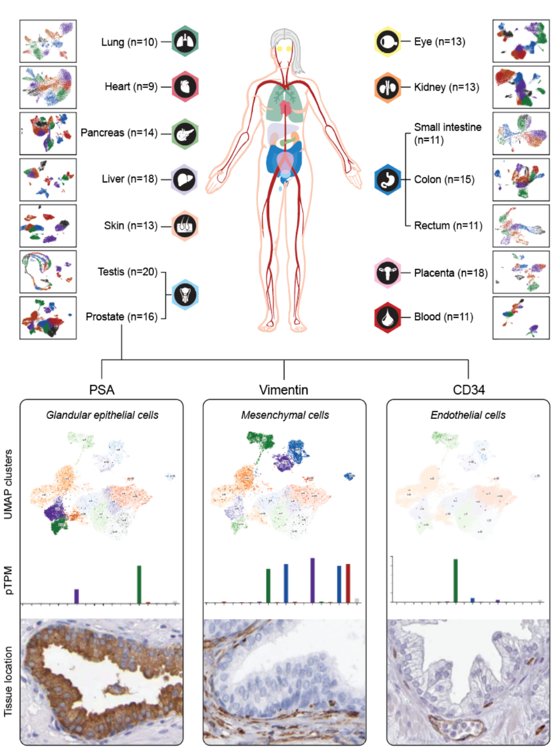
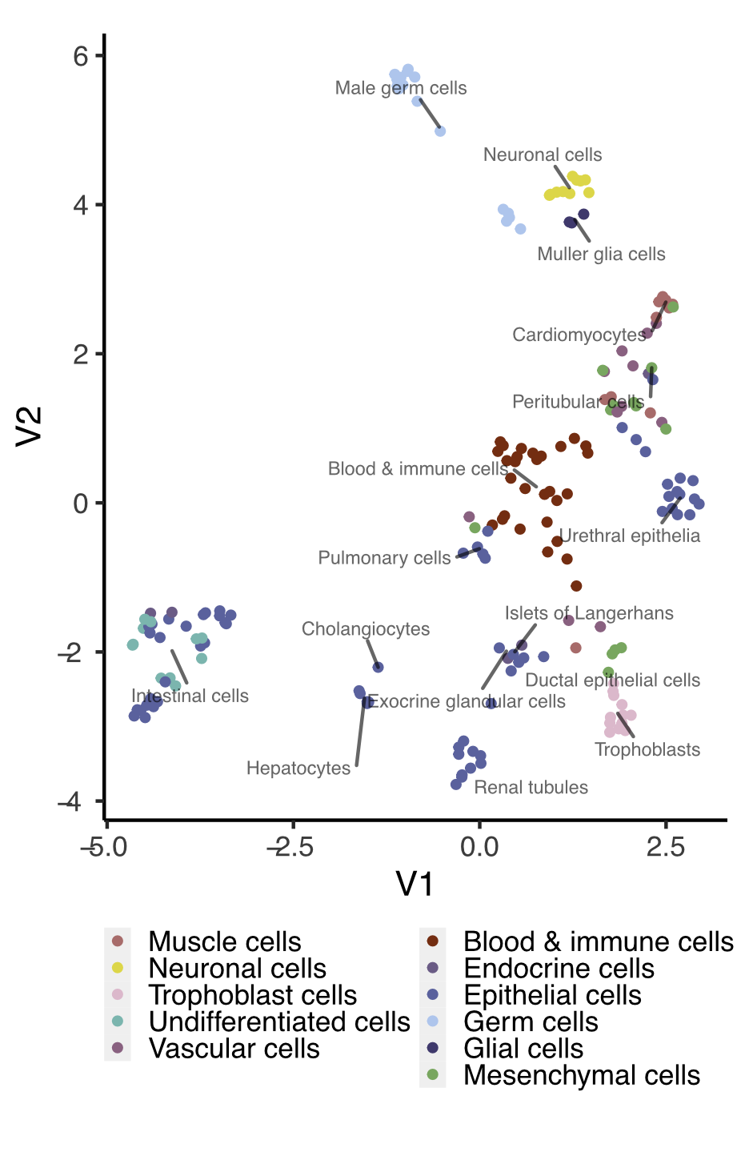
Figure 1
A
B
- 10

Slide 3
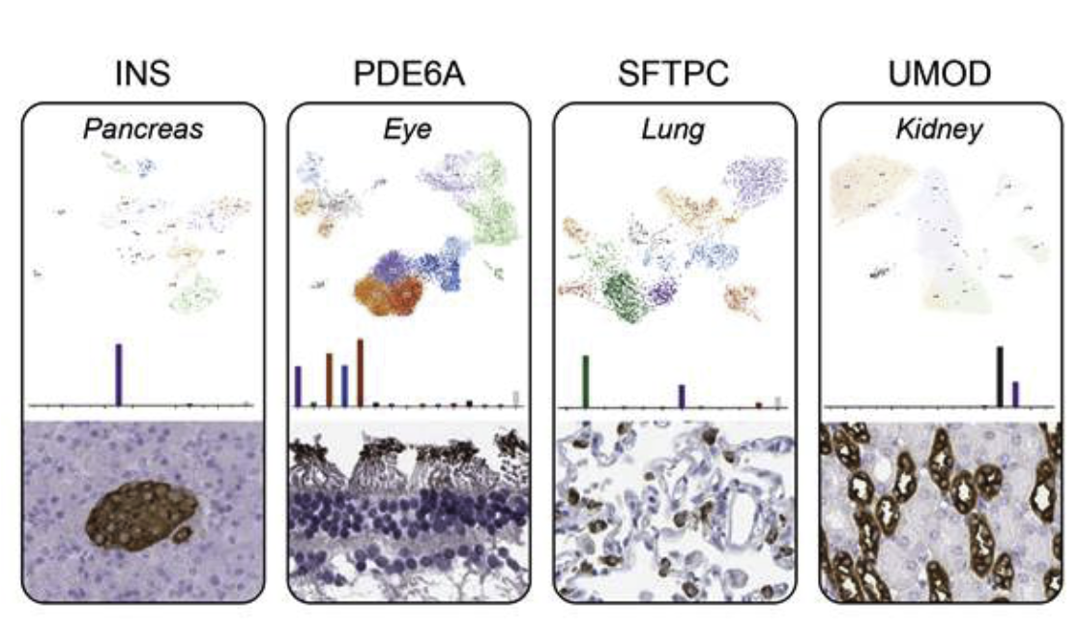
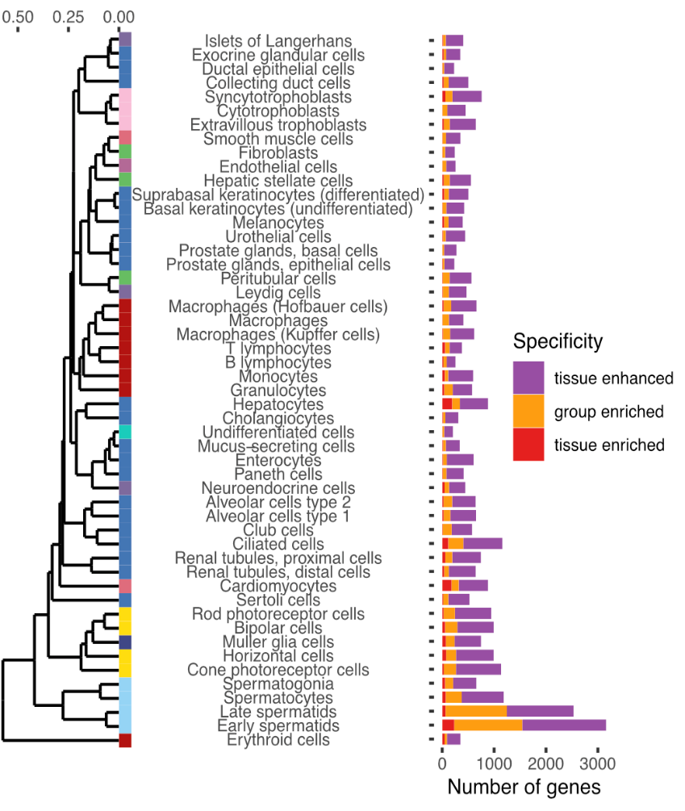
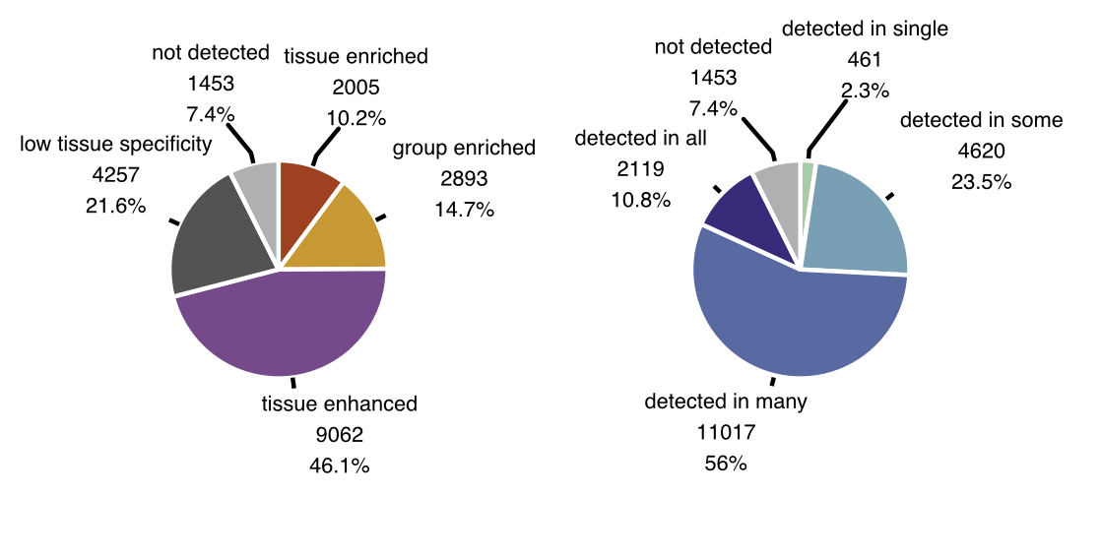
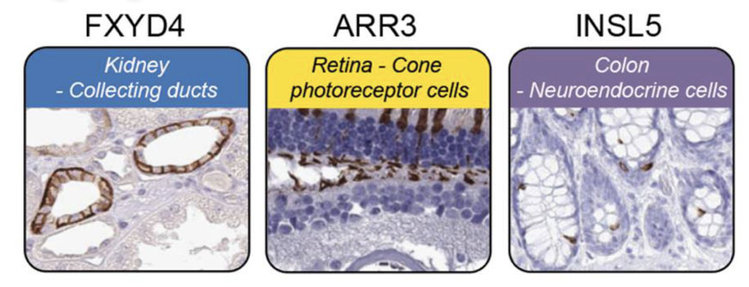
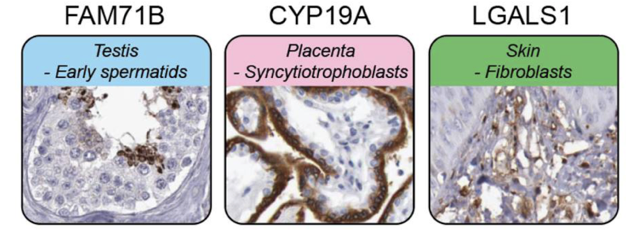
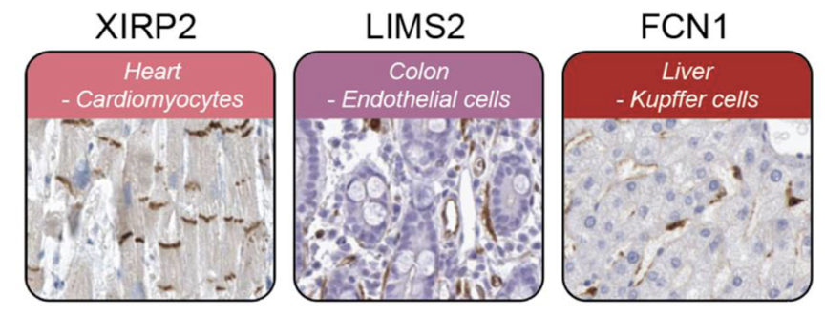
Figure 2
A
D
B
C
E

Slide 4
Figure 3

Slide 5
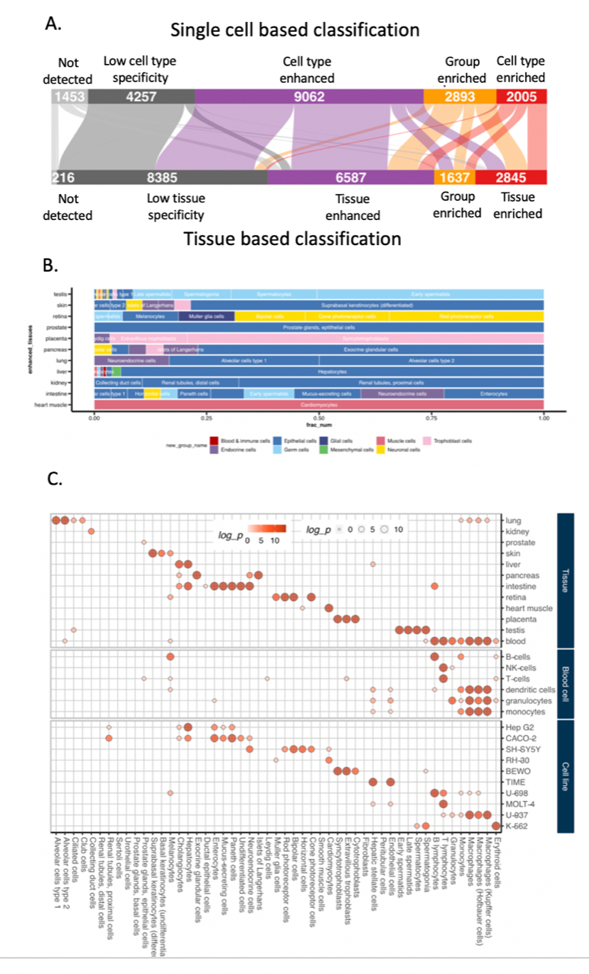
Figure 4

